Slide 1

Business proposal
By-Shashwat Kumar Mohanty
Electrical Engineering
Indian Institute of Technology B.H.U.(Varanasi)

Slide 2
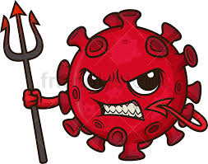
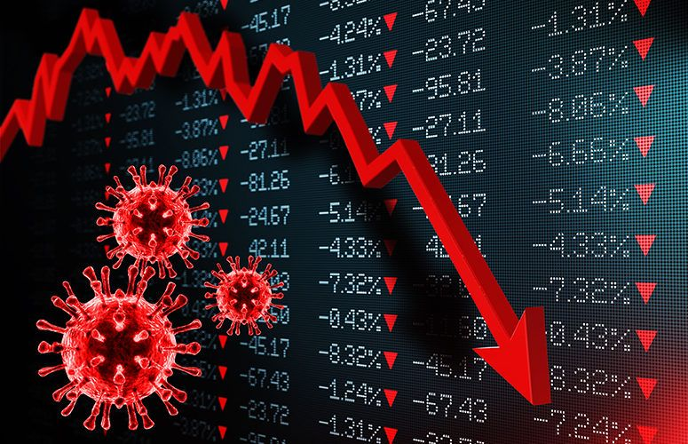
INTRODUCTION AND AIM
The economic impact of the 2020 coronavirus pandemic in India has been largely disruptive. India's growth in the fourth quarter of the fiscal Year 2020 went down to 3.1% according to the Ministry of Statistics. Notably India had also been witnessing a pre-pandemic slowdown, and according to the World Bank, the current pandemic has "magnified pre-existing risks to India's economic outlook".
During the lockdown, an estimated 14 crore (140 million) people lost employment while salaries were cut for many others. The Indian economy in other words is in doldrums .
We can clearly see that all E-Commerce and IT companies are flourishing in modern era but for manufacturing industrial companies its been a nightmare.
Everyone focuses on work from home but in steel plants or in manufacturing based companies we require the work force to operate the machines but in present scenario its seemingly impossible.
But If I say it is possible ? Won’t believe right but according to me if we adopt some innovative techniques its possible .
In my business proposal I have tried to incorporate innovation with workforce.

Slide 3
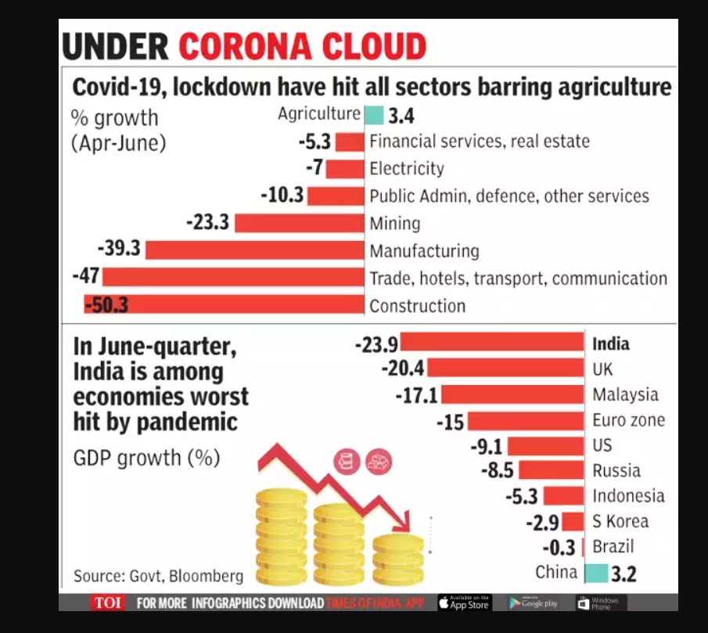
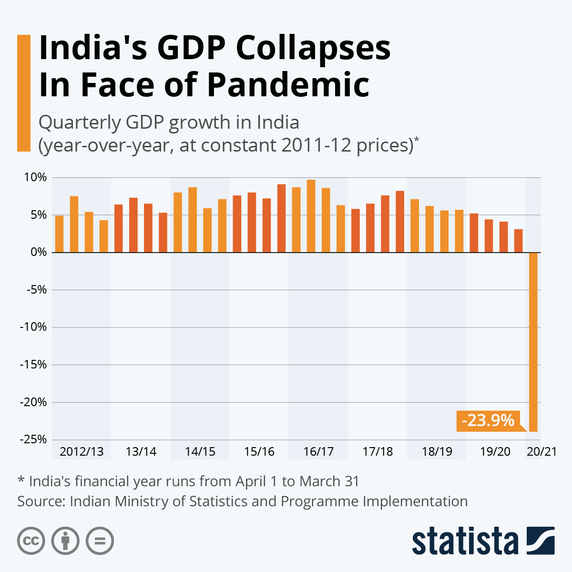
FACTS AND EVIDENCES
Its clear from these graphs that Indian economy is in doldrums and in mining and manufacturing sector the % growth is negative and most of our Indian industries depends upon these sectors, so it’s the need of hour to boost the economy of these industries.
Even from the press release of Jindal group Q4FY2020 its quite evident that the Jindal group of companies also has suffered much .So lets think about measures about how to come out from this treacherous trap.
In mission Aatmanirbhar Bharat Jindal group of company has massive role to play, lets move towards it.
WHO and ICMR have approved that social distancing is the only way to fight with this problem but generally everyone tends to forget that and in Un-lockdown phase in India is it possible? how to do it ??

Slide 4
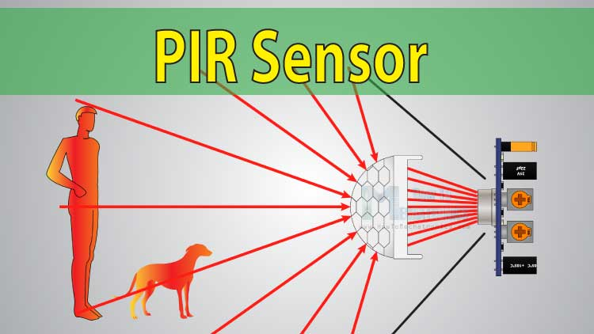
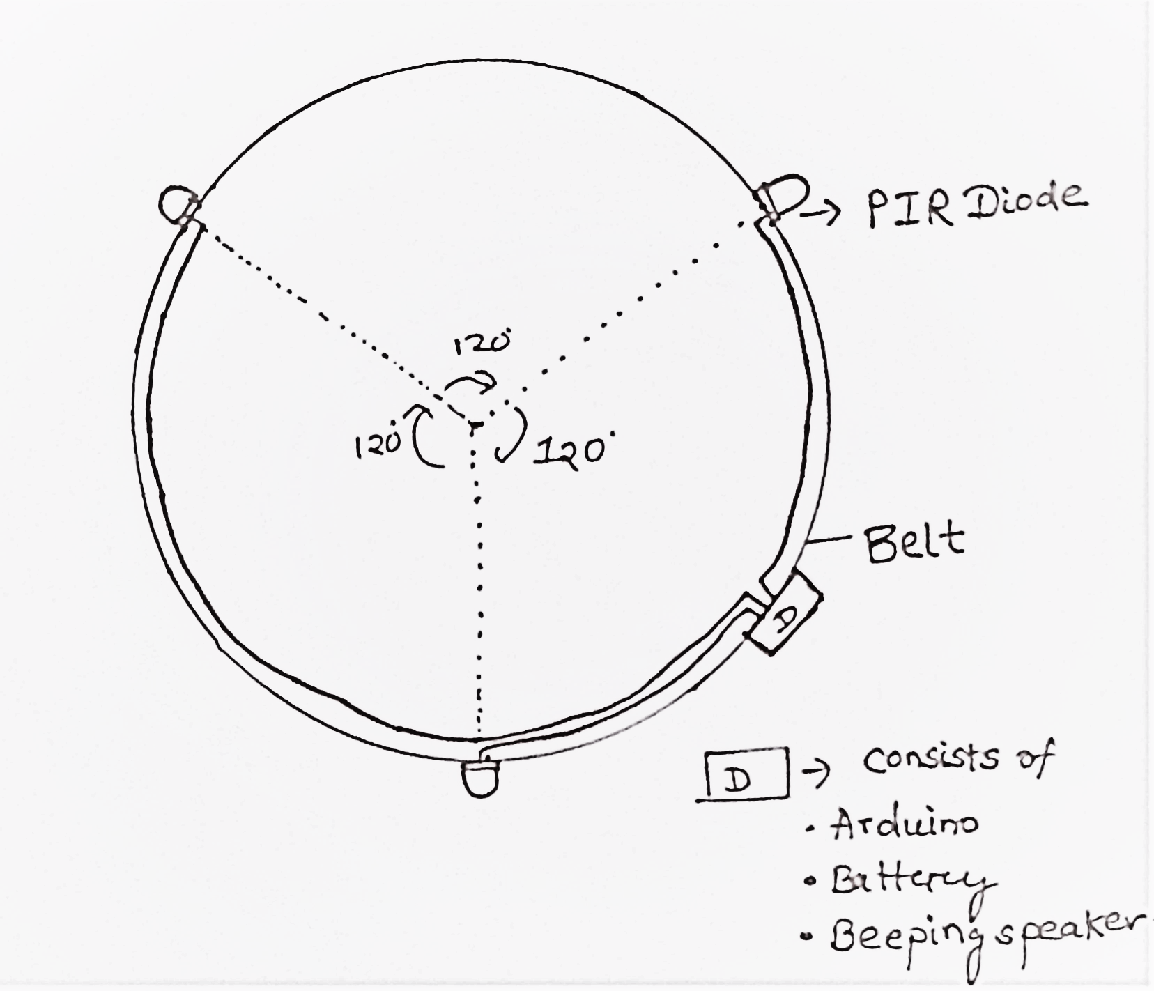
SOLUTION AND MITIGATION STEPS
SOCIAL DISTANCING IS NEED OF HOUR: BY THE HELP OF SURAKSHA KAVACH:
The workers in industries generally tend to forget or sometimes unknowingly come in contact of each other or with some item containing virus and if one is affected then all would be getting affected by it .I have tried to incorporate use of sensors technology .In this model I have taken inspiration from GPS system trilateration.
Main idea: Every worker would be wearing a belt in which 3 PIR sensors would be attached having an angle of 120 degree between each sensor and all these sensors will virtually form a circle of desired radius and whenever a person comes to a certain proximity it starts beeping until that person goes out of the radius.
Materials required: 1-Three Grove Passive Infrared Rays Motion sensor
2-Arduino circuit and Small Alarm Buzzer
3-Battery (9-12 V) and Connecting wire
We can set the distance range of this sensors to 2 metres and response time to be 0.3 second and would set it up in continuous mode so that continuous beeps are made until the person goes out of radius. The sensor works on basis of Infrared rays.
As a sport event the companies can also declare a prize for the person with minimum no of beeps in a month would get an award or a prize money then everyone would be taking the case seriously and social distancing is maintained also.

Slide 5
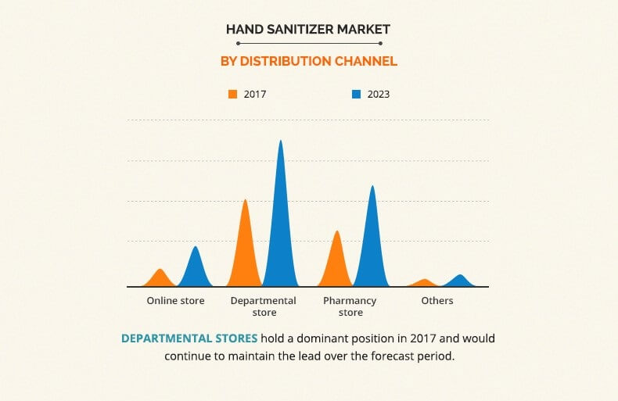
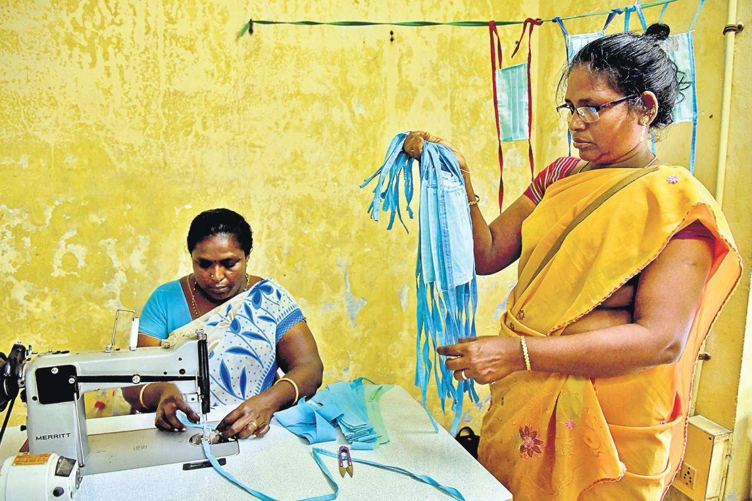
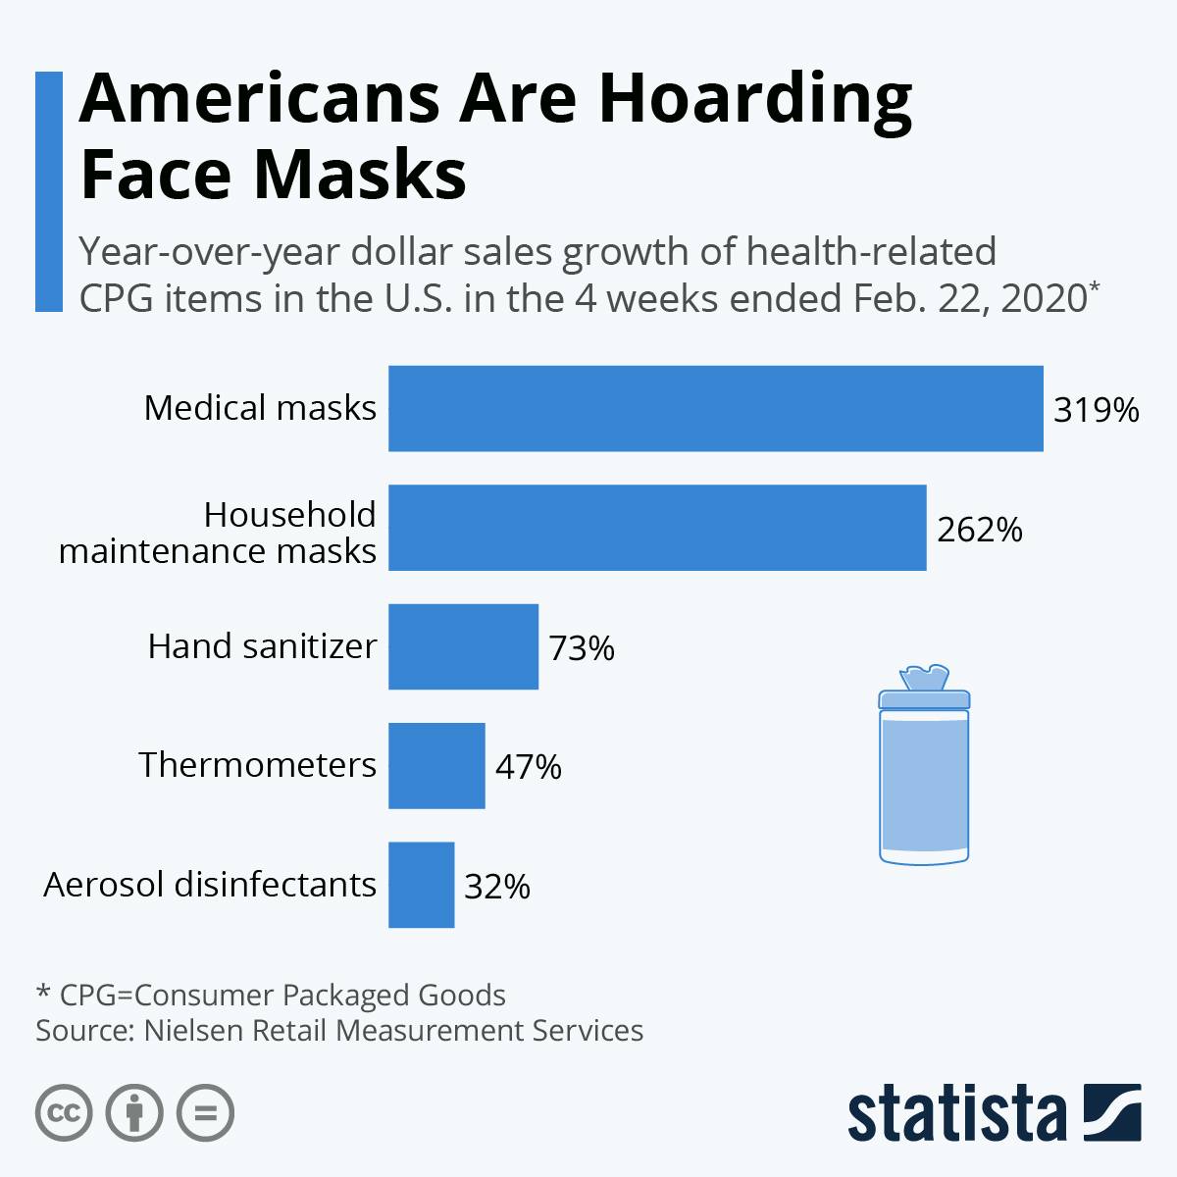
Manufacturing masks and sanitizers 2)-In Covid-era masks and sanitizers have become a basic amenity of life and as its becoming essential its market industries are rising by leaps and bounds as evident from graph , so most industries should employ women for stitching masks and producing sanitizers in industry as this would not only be a service to mankind rather the company gets benefitted also and this can also be used by workers ensuring their safety. OP Jindal group has started making masks which can be seen in the photo below now addition to it there should be sort of digitization in form of an E-Commerce website where business can be facilitated as well. 3)-Another facilitation to the steel industry is we could build an application which would connect the local unemployed drivers with manufacturing companies like OP Jindal group so as to deliver the goods to the required location. Basically its like forming a chain to supply the goods.

Slide 6
POSITIVE CONSEQUENCES
1-Using SURAKSHA KAVACH we can have workers to work in industries which would decrease unemployment drastically and also reducing violence activities in society.
3-Most importantly it would contribute to India’s GDP as well thereby stepping towards
AATAMNIRBHAR BHARAT.
It might seem that once COVID problem is solved then this model won’t be of any use rather these sort of virus are quite periodic in nature and will emerge after few years again.
4-The software application built would connect different automobile drivers and by forming a human chain they can deliver goods produced inside our country also.
2-Here when we form a industrial unit of masks and sanitizers we are contributing to women empowerment as well.

Slide 7
FINANCIAL FORECAST
SURAKSHA KAVACH is a very low cost and feasible product and in present scenario when social
distancing is the key , its quite desirable to have the device. Here is its cost estimate:
Rounding up total cost of making this setup we need Rs. 420-450 which is quite less and feasible for every worker. All these are materials are easily available so its economically viable too.
Production of sanitizers requires very less capital but production and selling would generate a high source of income.
Proper functioning of software application would lead to digitization of industry and would result back in high turn-over.
S.NO | ITEM NAME | COST(IN RS.) | QUANTITY | TOTAL COST (IN RS.)
1 | PIR SENSORS | 70 | 3 | 210
2 | ARDUINO UNO | 180 | 1 | 180
3 | ALARM BUZZER | 15 | 1 | 15
4 | BATTERY | 10 (APPROX) | - | 10

Slide 8
LIMITATIONS AND ADDITIONS
On addition of all these components we can ensure more safety and efficiency of devices
1)-In the SURAKSHA KAVACH we use PIR sensors which work on detecting infrared rays emission. So if worker is working in a zone where infrared rays are already involved it would continuously beep so a better solution is automation of those parts of industries where workforce won’t be involved , along with it may beep also if animal comes to its proximity we can adjust that by using a grid eye sensor set up which would detect human beings only .The total cost would then be around Rs. 1250-1400.
2)-While production of sanitizers and mask some investment needs to be made but it would not only serve the mankind but also would produce high revenue.
3)-Coming to software application it has very high positive effects but one matter of concern is while transferring of goods the drivers may come in contact and as they live in nearby areas some bond might be there so they would tend to forget social distancing but if we provide the SURAKSHA KAVACH then social distancing will be maintained also.
4)-Apart from all these we need to use Sensor tap system in which a person just has to move his hand across the tap and water automatically flows until he withdraws and there are very numerous example of their uses.

Slide 9
SUMMARY
COVID CRISIS
India‘s GDP is progressively decreasing,
Everyone needs to contribute to increase GDP
SURAKSHA KAVACH
A PIR sensor based model fit on belt which ensures social distancing of every worker and in addition with masks and sanitizers we can ensure their safety as well .In addition we should opt for sensor based untouched taps and sanitizers
SANITIZERS AND APPS
In COVID era these have become basic amenities and its quite a social service and gaining form the big market also as well as ensuring safety of workers also.
Manufacturing sector are suffering most.
Then how companies would ensure safety of workforce?

Slide 10
Thank You Lets save our country COVID LOSES , INDIA WINS

